Slide 1
Creating Page Layouts w/CSS: Grid
CS 130: Tools and Technologies of the World Wide Web
Spring, 2022

Slide 2
Outline
Flexbox: Review
Create this layout:

Slide 3
Flexbox: Reminder
Parent Container Put the display into “flex mode” display: flex and then use the following properties to align the child items:
align-items: (flex-start, flex-end, space-around, space-between, center)
justify-content: (same as align-items)
flex-direction: (row, column, row-reverse, column-reverse)
flex-wrap: (no-wrap, wrap, wrap-reverse)
Child Container
Apply sizing to the child container as needed.

Slide 4
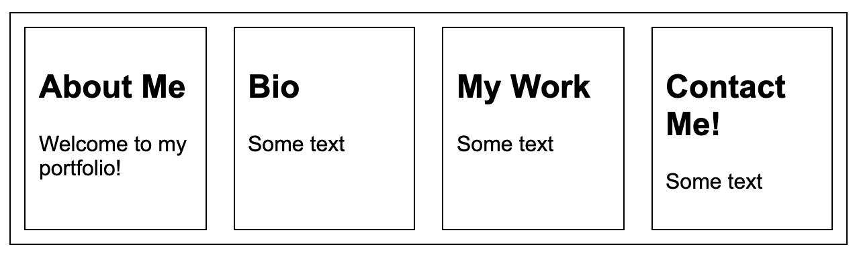
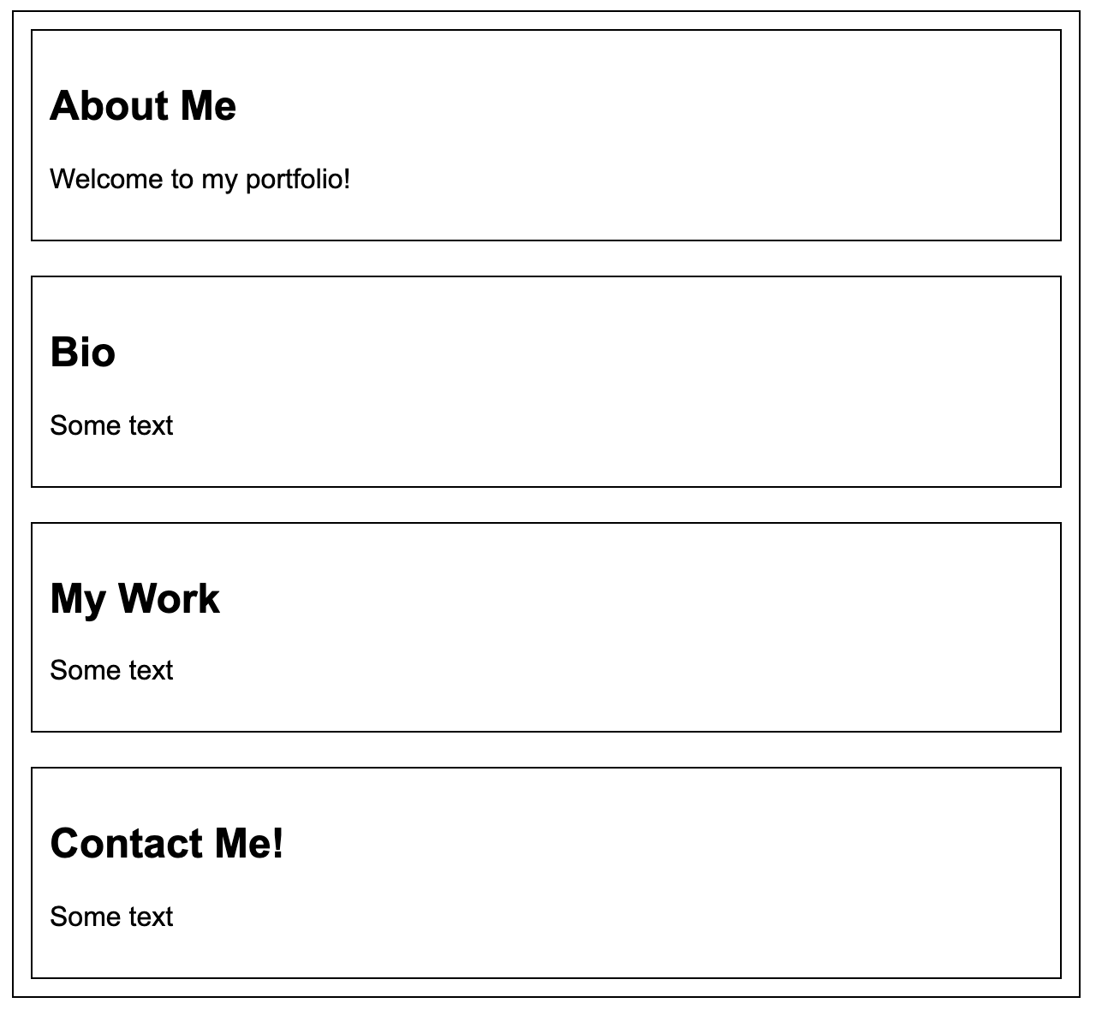
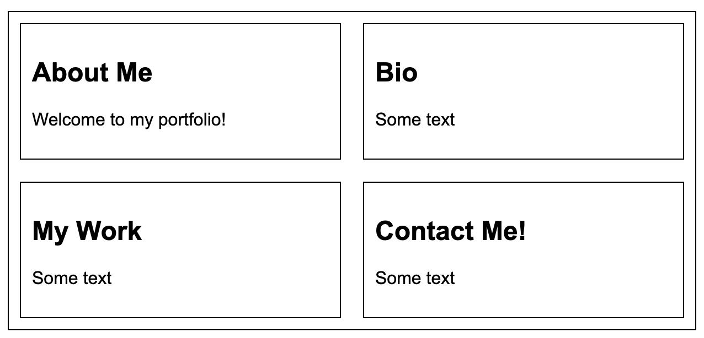
Flexbox + Media Queries Practice
Make it so that #1 is for Desktop screens, #2 is for Tablet, and #3 is for Mobile
1
3
2

Slide 5
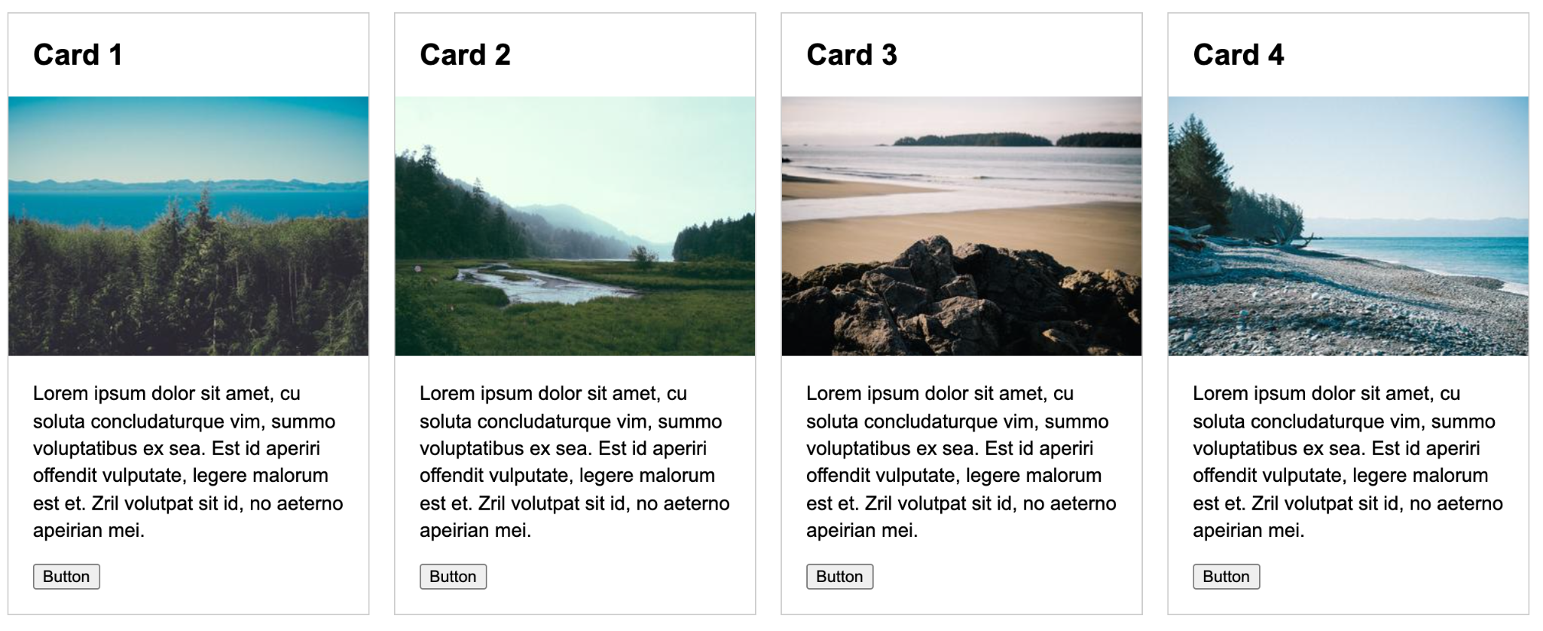
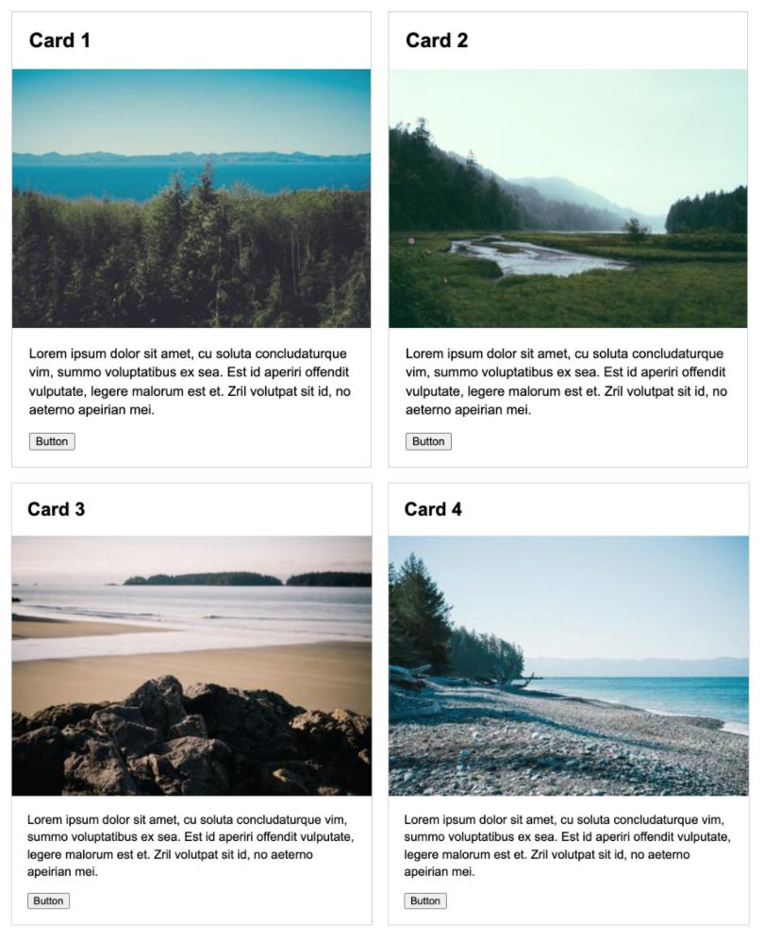
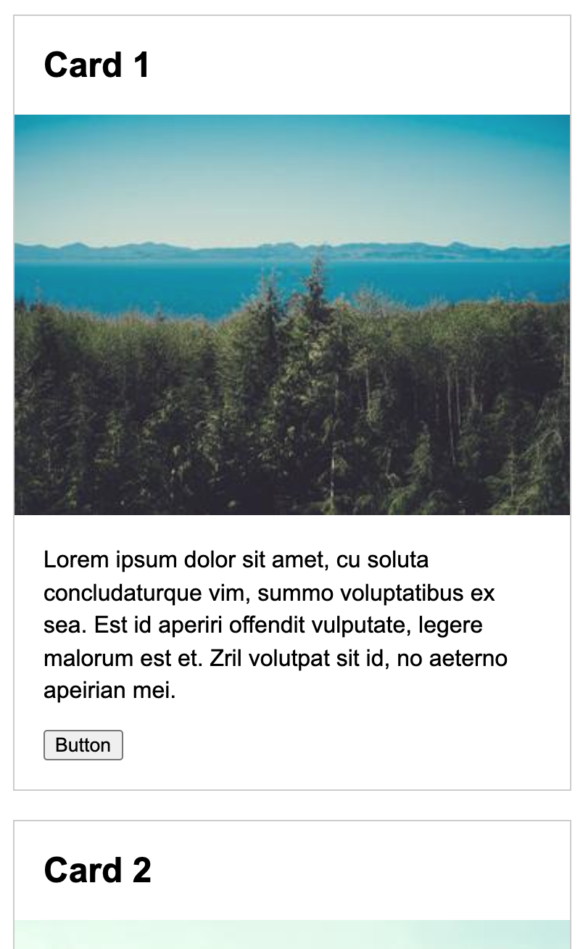
Flexbox + Media Queries Practice
Open 03-flexbox-media-queries and create these screens:
Desktop
Tablet
Mobile

Slide 6
Flexbox: Practice 3: Navigation Bar
Open 04-nav-bar, and try to make the following:

Slide 7
CSS Grid

Slide 8
CSS Grid
Give you more control re: how your website is laid out in both the horizontal and vertical directions.
See this link for more details re: when to use flex v. grid
Key grid properties for parent:
grid-template-rows
grid-template-columns
grid-template-areas
row-gap and column-gap
Key grid properties for children:
grid-column-start
Grid-column-end (with or without span keyword)
grid-area

Slide 9
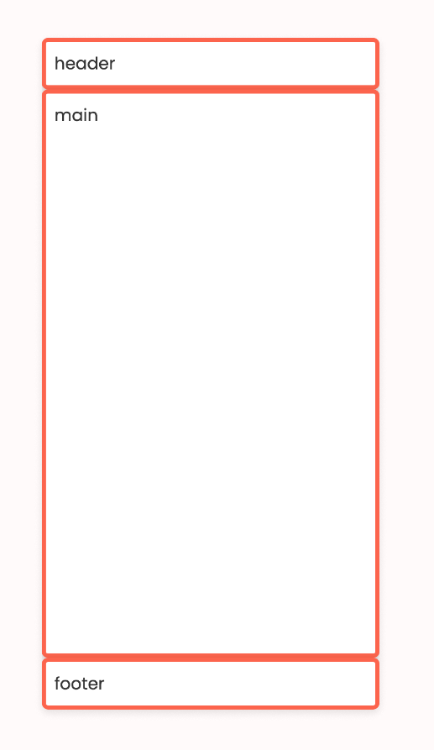
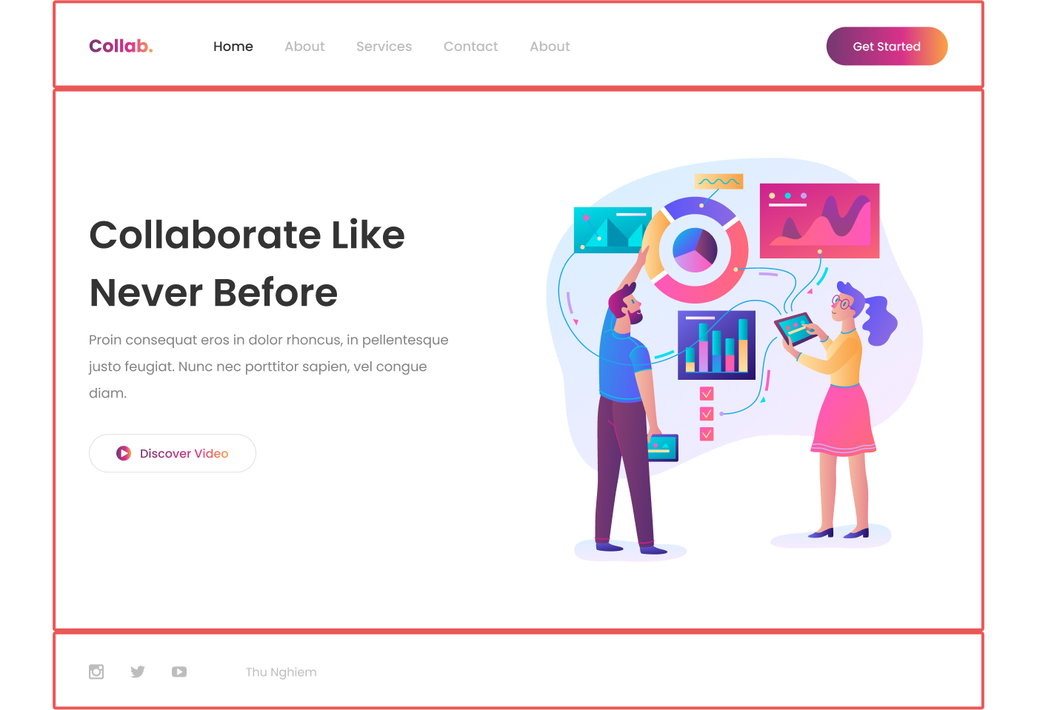
Exercise 1: Create this Layout (01-pancake)

Slide 10
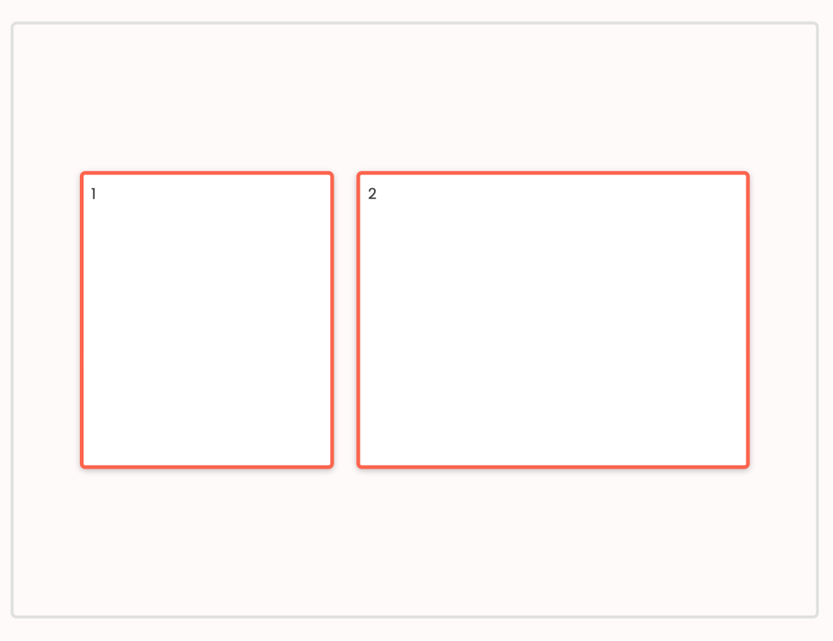
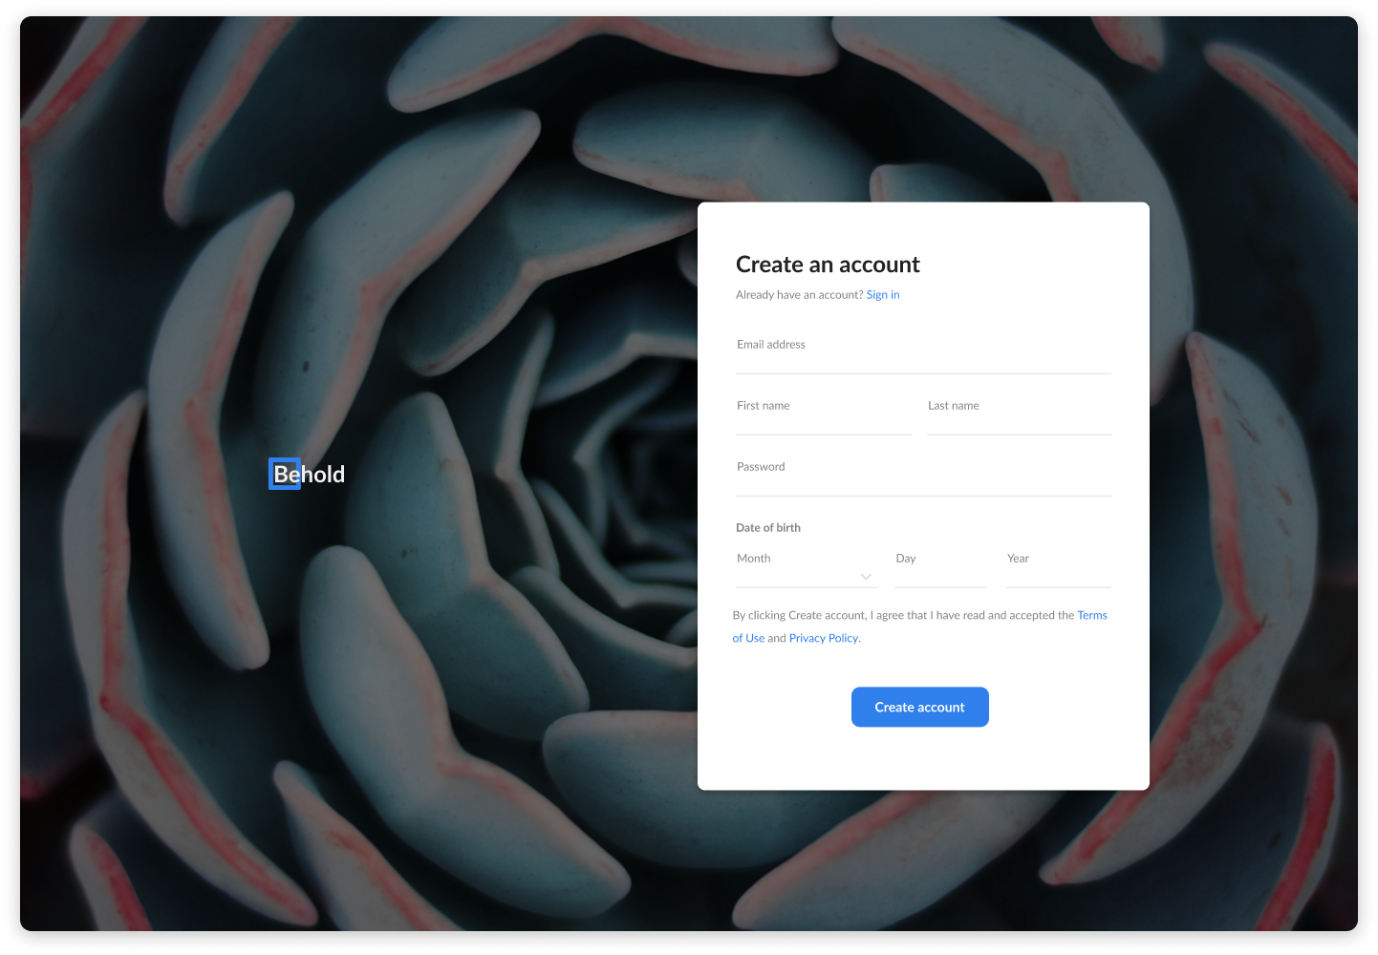
Exercise 2: Create this Layout (02-twelve-column-grid)

Slide 11
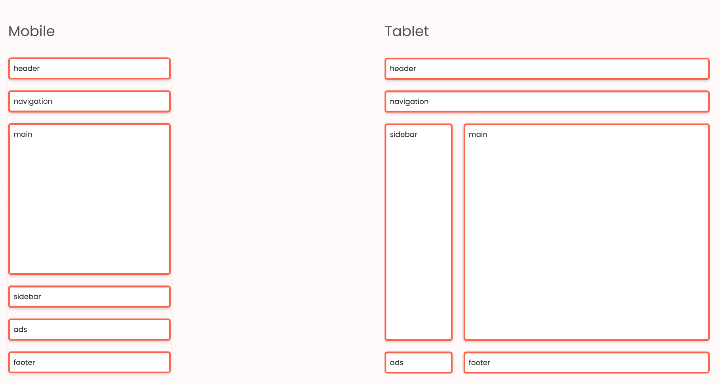
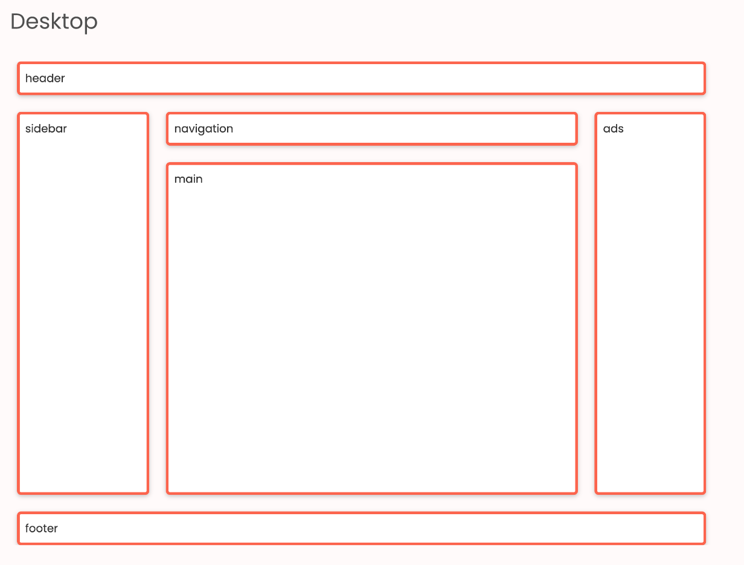
Exercise 3: Create this Layout (02-responsive-layout-grid-template-aras)

